Slide 1
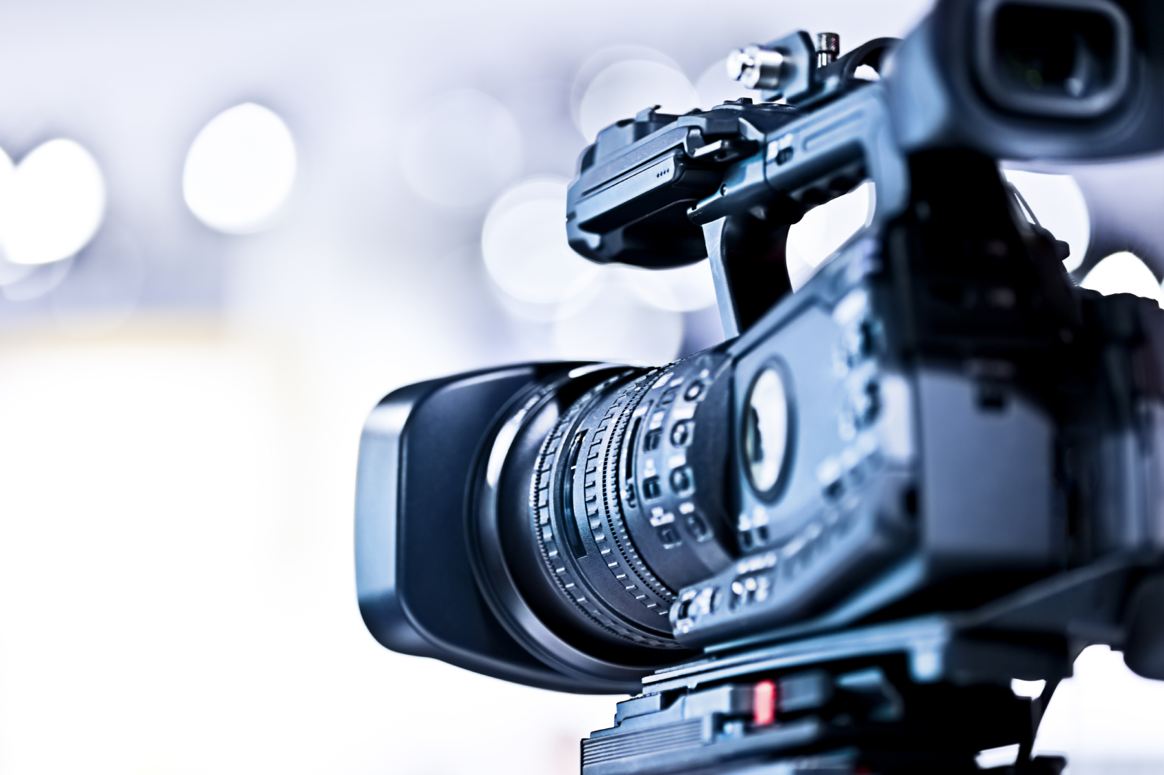
Intro to Video
Production

Slide 2
Video Cameras
3 Levels of Cameras
Consumer
Prosumer
Professional

Slide 3
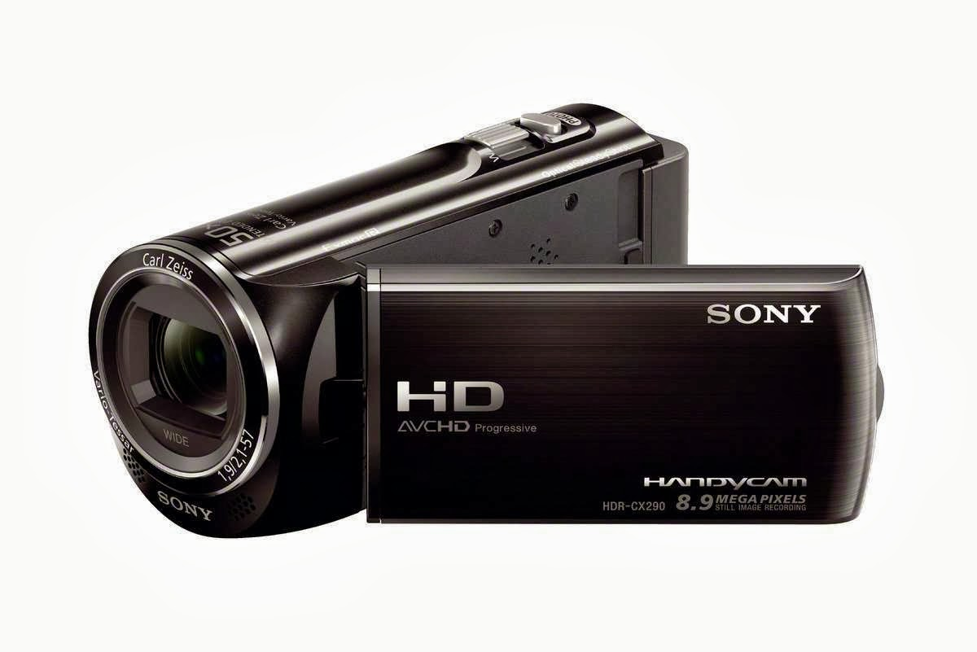
Video Cameras
Consumer
-Small. Fits in the palm of your hand.
-Typically has a “fixed” lens (this means that the lens is attached to the camera and cannot be removed).
-Usually has minimal control over settings such as color and frame rate. Great for portability!

Slide 4
Video Cameras
Consumer
Format:
-Videotape (Beta, Cassette, Mini DV)
-Flash memory (No Memory Card, No Videotape, No DVD)
-DVD
-Memory Card (SD Card)

Slide 5
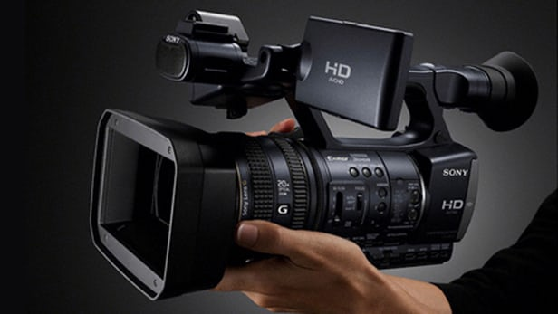
Video Cameras
Prosumer
-Has professional level features, but simple and affordable for consumer use.
-Typically allows users more control over focus, white balance, color, and audio than consumer level cameras.

Slide 6
Video Cameras
Prosumer
-Commonly used for student/independent films, weddings, company videos, and freelance videography work.
-Price range = $1,000 - 10,000

Slide 7
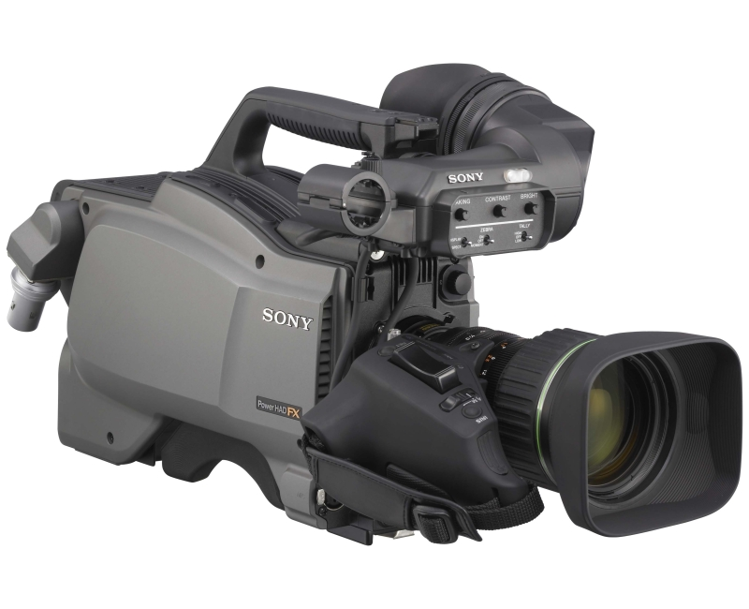
Video Cameras
Professional
Come in all shapes and sizes. Have much greater control over settings than consumer and prosumer level cameras. The lens is usually removable and can cost about as much as the camera.

Slide 8
Video Cameras
Professional
Many professional video cameras record to memory cards or tapes, however, many are usually connected by cable or wireless connection to another source such as a separate tape or video recorder.
Typically used for television shows, sporting events, and movies!

Slide 9
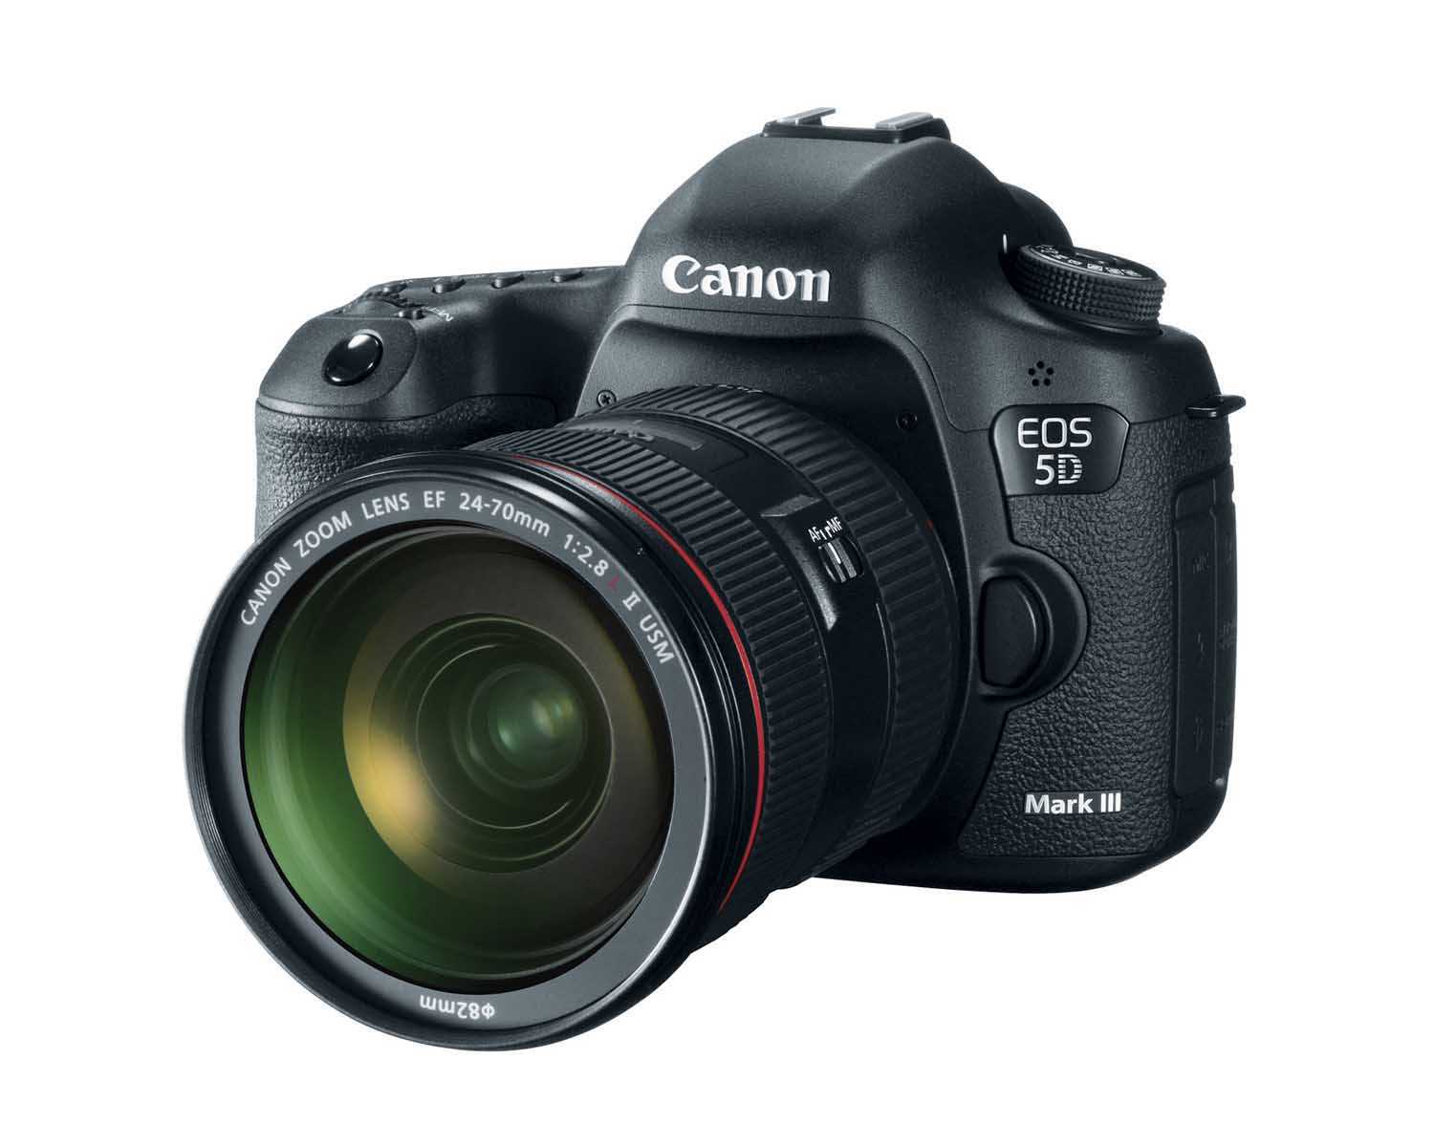
Video Cameras
Digital Single-Lens Reflex (DSLR)- Small. Utilizes a small mirror inside the camera to reflect the image up into the viewfinder (hence the term “Reflex”).
Does both still photos AND video. Video quality is often very high, however, record time is often very short compared to most other types video cameras. But record time has increased drastically in recent years.

Slide 10
Video Cameras
Why is the video quality so high on DSLRs?
An average still photo holds more pixels than an average frame of video. Because DSLRs are designed to take high quality photos, the video often turns out to be high quality as well.
Typically used for video shoots, film shoots, sporting events.

Slide 11
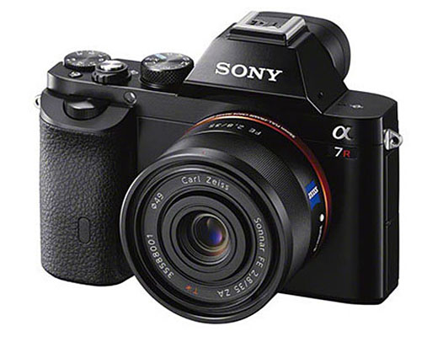
Video Cameras
Mirrorless Interchangeable Lens Camera- Similar to DSLR, but without the mirror.

Slide 12
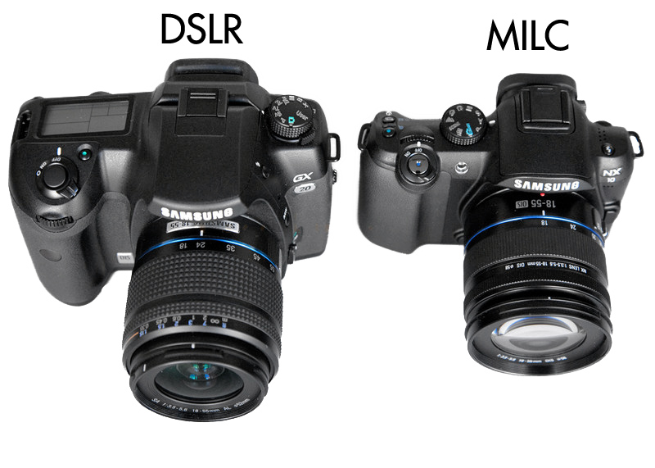

Slide 13
Components of a Camera
Lens
Focus Ring – Used for adjusting focus.
Push and Pull Control Ring – Used for pushing and pulling toward an object. AKA- Zooming In and Zooming Out.
Shutter Button
Viewfinder
LCD Screen

Slide 14
Components of a Camera
Lens Release – Usually located where the lens connects to the camera body.
Flash
Hot Shoe – A mount (usually metal) located on top of the camera.
- Can be used to
mount external
microphones
and flashes.

Slide 15
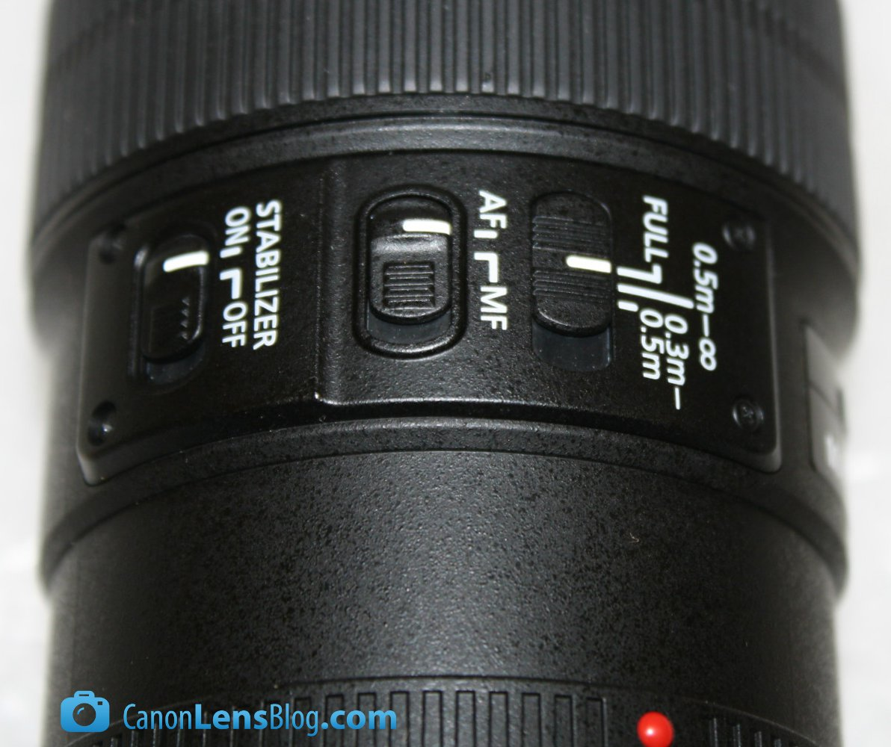
Components of a Camera
Focus Mode Switch – Usually labeled as AF and MF. Located along the side of the lens. Allows the user to switch between Automatic Focusing and Manual Focusing.

Slide 16
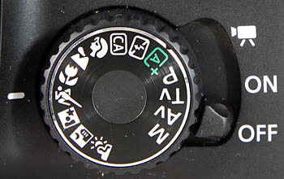
Components of a Camera
Mode Switch – Allows the user to switch between shooting modes.

Slide 17
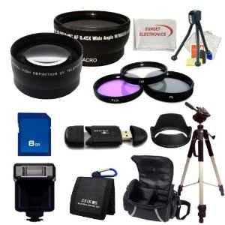
Camera Accessories

Slide 18
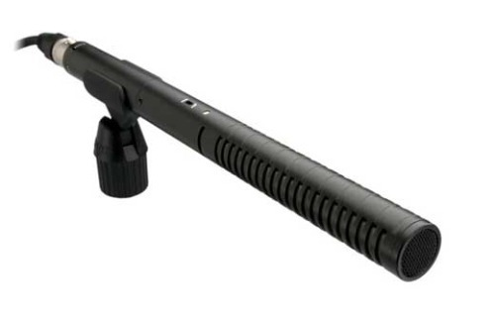
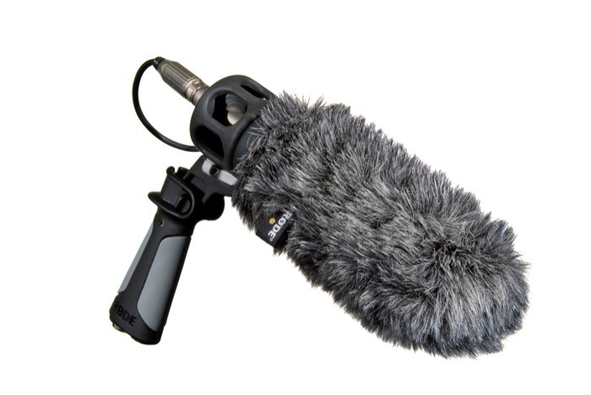
Camera Accessories
Camera Strap
Lens Cap
Microphone
Shot Gun - Picks up sound from whatever direction it is pointed in.
(With Fur Windscreen)

Slide 19
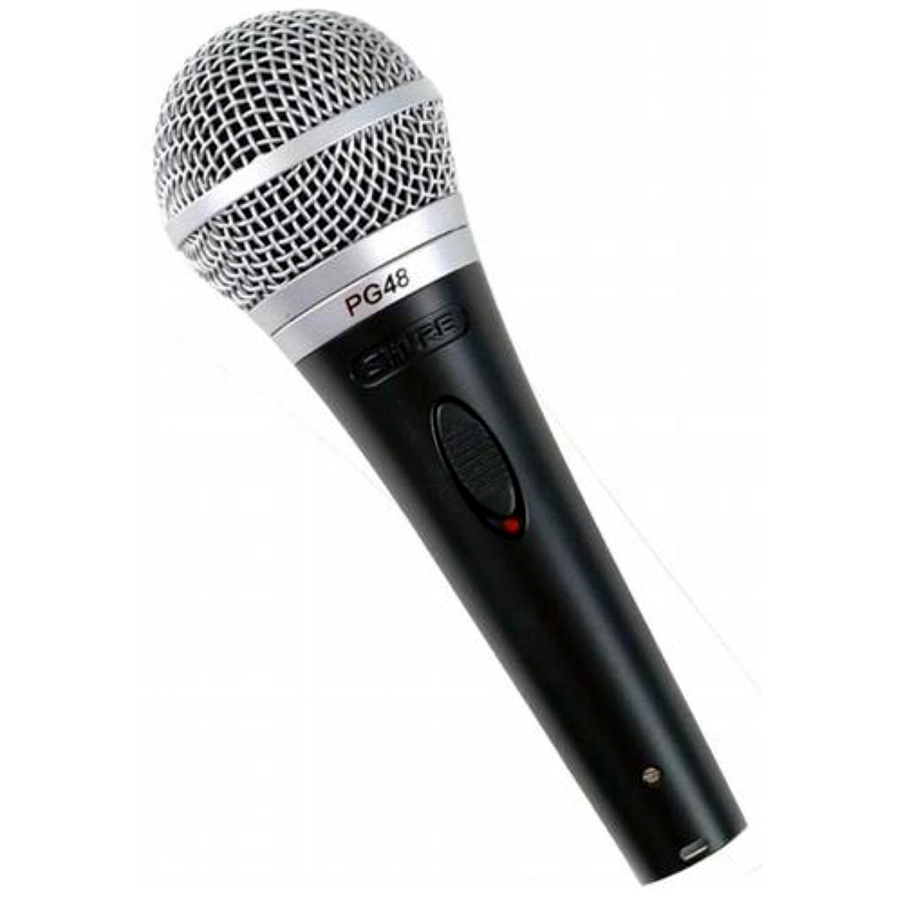
Camera Accessories
Camera Strap
Lens Cap
Microphone
Handheld – Can be wireless or wired. Typically used for news broadcasts or interviews.

Slide 20
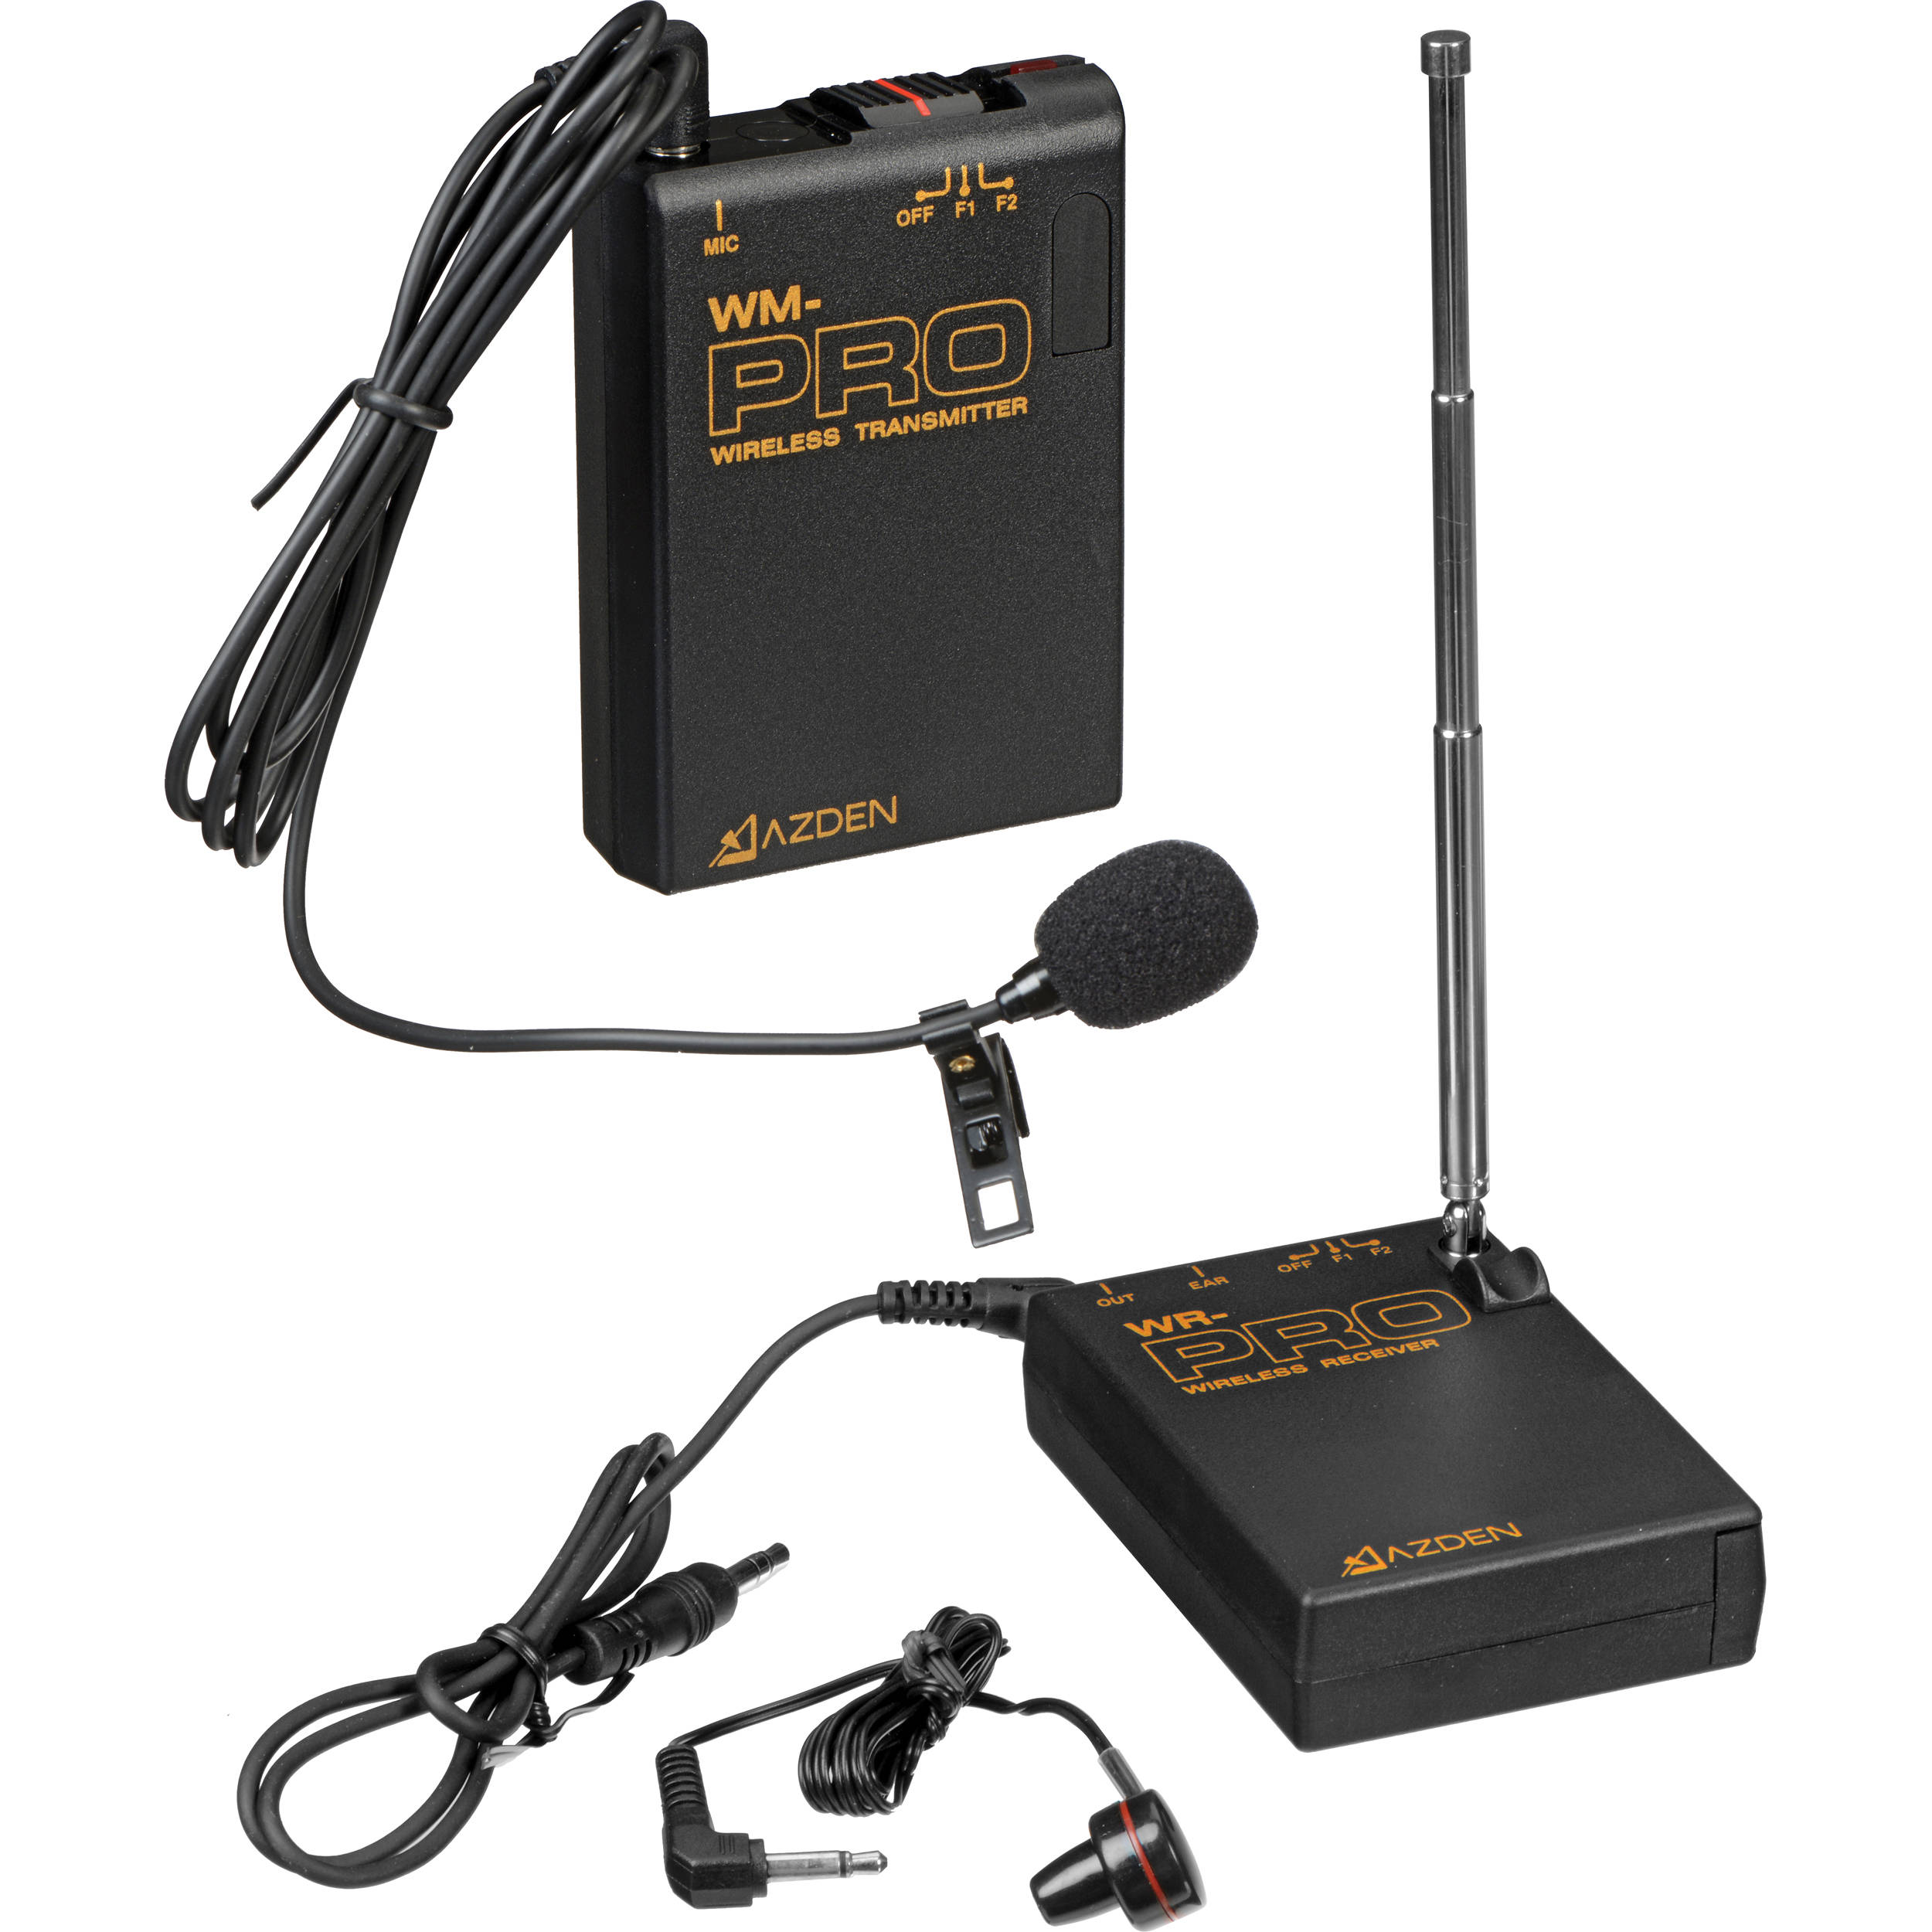
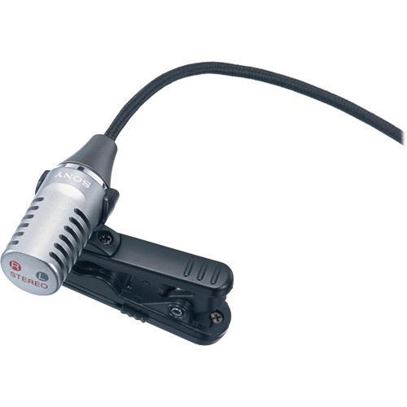
Camera Accessories
Camera Strap
Lens Cap
Microphone
Lavalier (Lapel) – Small. Clips to a person’s clothing. Can be wired or wireless. Commonly used during television broadcasts (news interviews, late night talk shows).

Slide 21
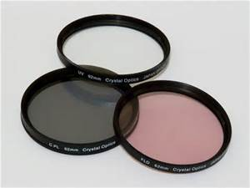
Camera Accessories
Carrying Case
Lens Cleaning Kit
Tripod
Lens Filters – Attach to the end of the lens. Are used to enhance the look of photos and videos.

Slide 22
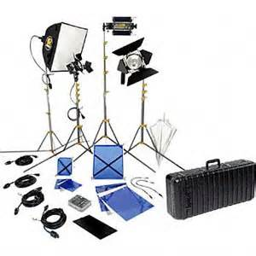
Camera Accessories
Lighting Kit

Slide 23
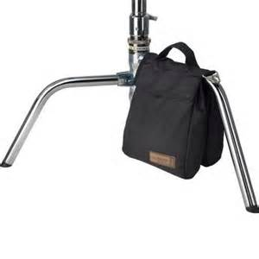
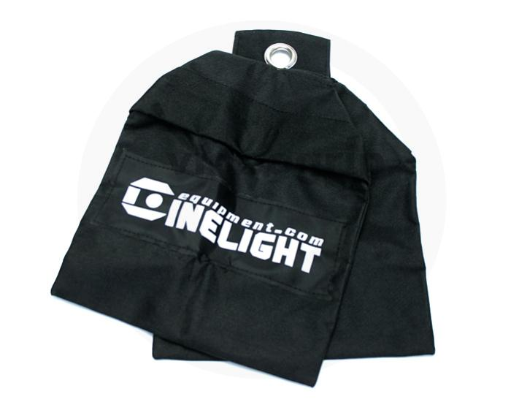
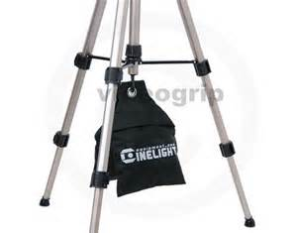
Camera Accessories
Sandbags -
Used when filming outdoors. Helps weigh down lighting fixtures and camera tripods.

