Slide 1
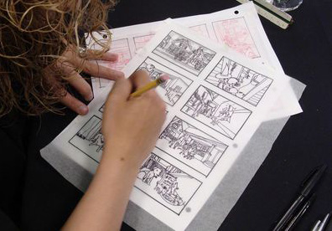
Storyboarding

Slide 2
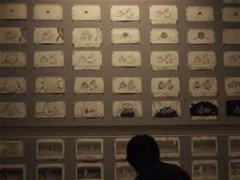
Storyboards are pictures, hand drawn or computer generated, that represent shots that a director plans to use for a film or tv show

Slide 3
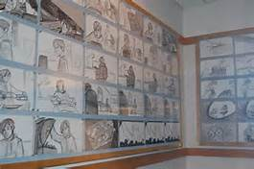
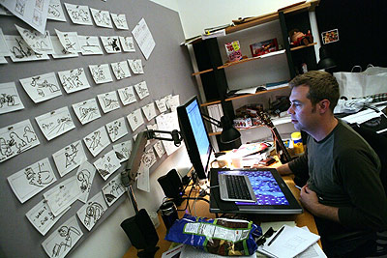
Some movies, especially animated films or films with heavy amounts of CGI or action, are storyboarded almost entirely from beginning to end

Slide 4
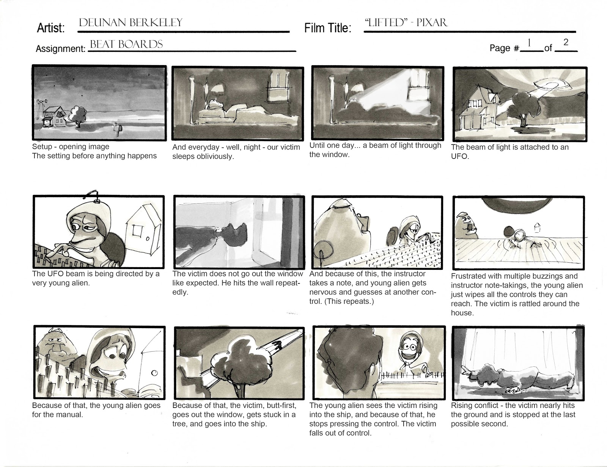
Storyboards help storytellers visualize a movie before it goes into production
Storyboarding helps save money and time

Slide 5
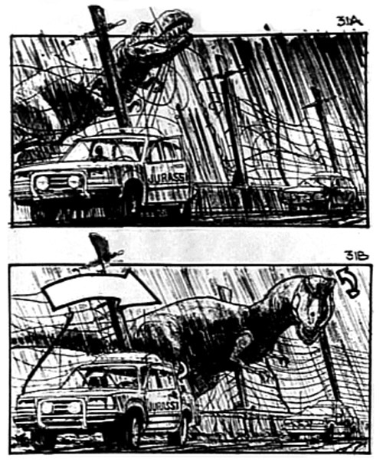
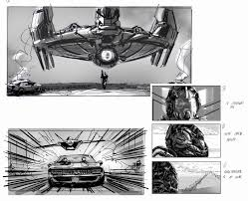
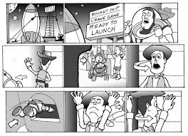
Labeling
Labeling each storyboard slide is extremely important
Proper labeling can help increase visualization
-In other words, it helps paint a clearer picture of what is taking place in your scene and how it is going to look.

Slide 6
Labeling
Every storyboard artist is different
Every storyboard layout is different
However, there are still a few key elements that every storyboard should have when it comes to labeling…

Slide 8
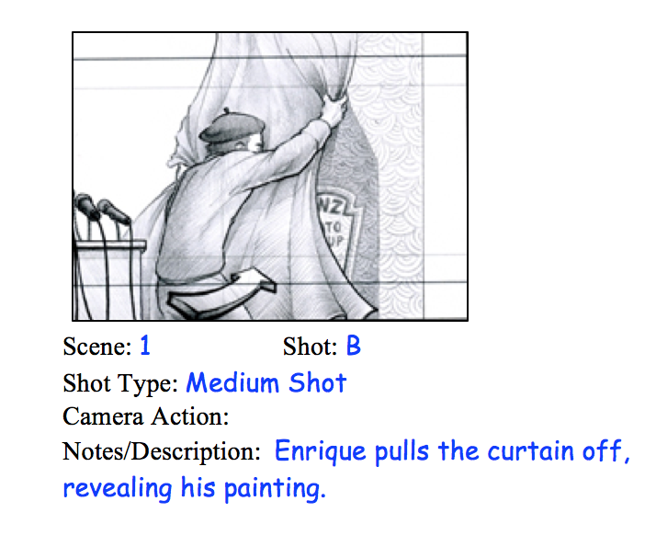
Labeling
Scene and Shot number/letter

Slide 9
Labeling
      Shot Type

Slide 10
Labeling
      Camera Action

Slide 11
Labeling
      Notes/Description

Slide 12
Tips for Sketching…
Use arrows
Draw facial features:
    Eyes and noses can help indicate the direction an actor should be looking.
=-
=-
=-
=-

Slide 13
Examples…

Slide 15
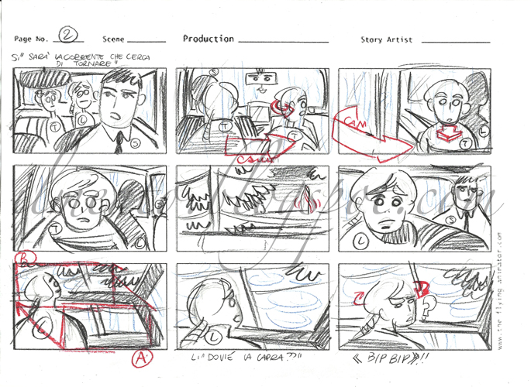

Slide 17
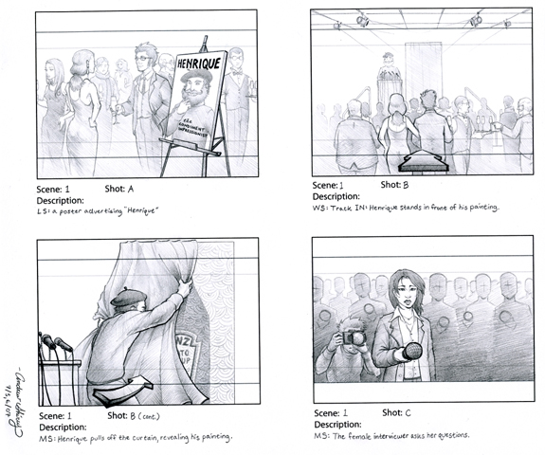

Slide 18
Now it’s your turn!
In groups of 3-6, you and your group members will create a storyboard using the storyboard worksheet provided. You must use both sides of the sheet. It will be worth 24 points (2 pts per slide). It is due at the end of the period. You will present these to the class tomorrow!

