Slide 1
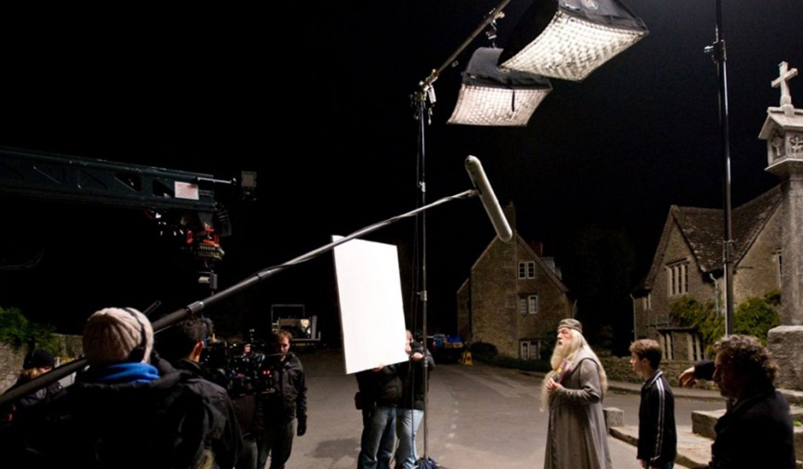
Lighting

Slide 2
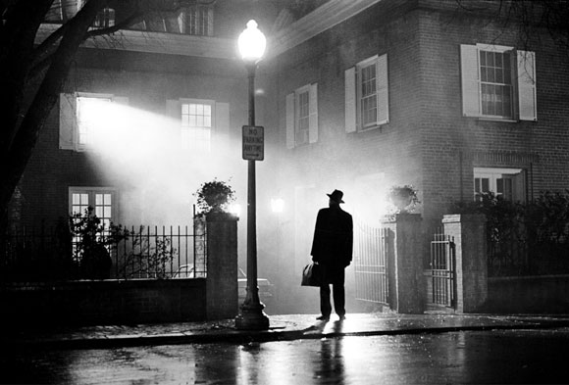
Lighting
Lighting is one of the most important, yet most unnoticed aspects of film.
Lighting determines the quality of your project
Bad lighting = Bad footage
Good lighting = Good footage
Lighting can determine mood
Lighting can improve the appearance of actors, sets, and objects on sets

Slide 3
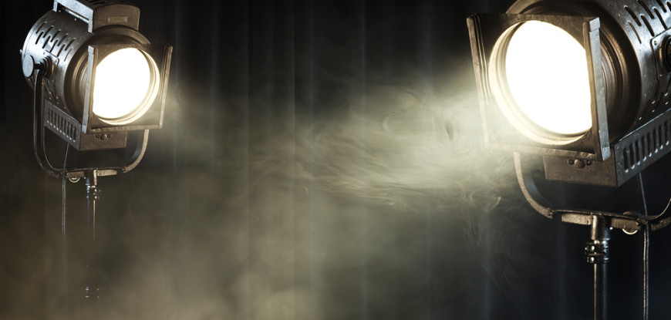
Basic Lighting Techniques
3 Point
2 Point
1 Point

Slide 4
Basic Lighting Techniques
3 Point Lighting
The most standard/common lighting of the three basic lighting techniques.
Gives your subject a three dimensional appearance.
Consists of three points of light…
Key Light
Fill Light
Backlight

Slide 5
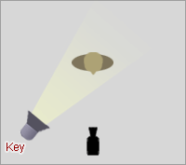
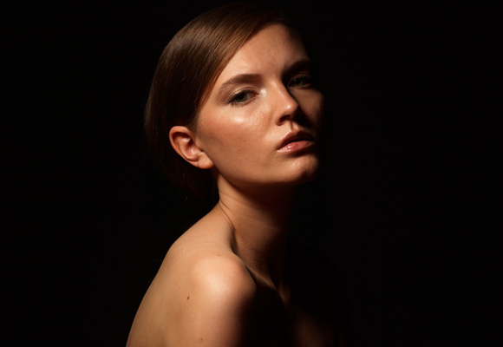
Basic Lighting Techniques
3 Point Lighting
1. Key Light: The key light is the main light. It is usually the strongest and has the most influence on the scene. It is placed to one side of the camera or subject so that that side is well lit and the other side has some shadow.

Slide 6
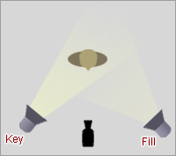
Basic Lighting Techniques
3 Point Lighting
2. Fill Light: The fill light is the secondary light. It is usually placed on the opposite side of the key light and used to fill in shadows.
*Typically softer than the key light.

Slide 7
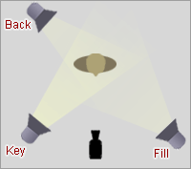
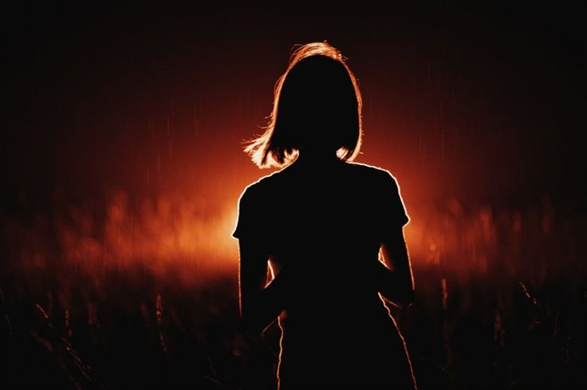
Basic Lighting Techniques
3 Point Lighting
3. Backlight: Placed behind the subject to light them from behind. Highlights the subject’s outline and separates them from the background.
* Must be pointed at the subject (not the background)
Otherwise it’s considered a “Background” light :)

Slide 8
Basic Lighting Techniques
3 Point Lighting

Slide 9
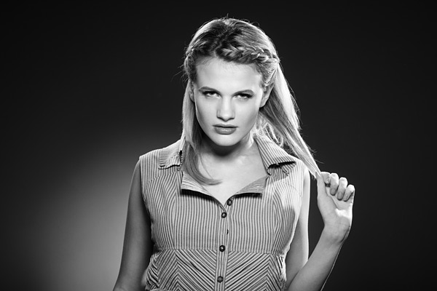
Example

Slide 10
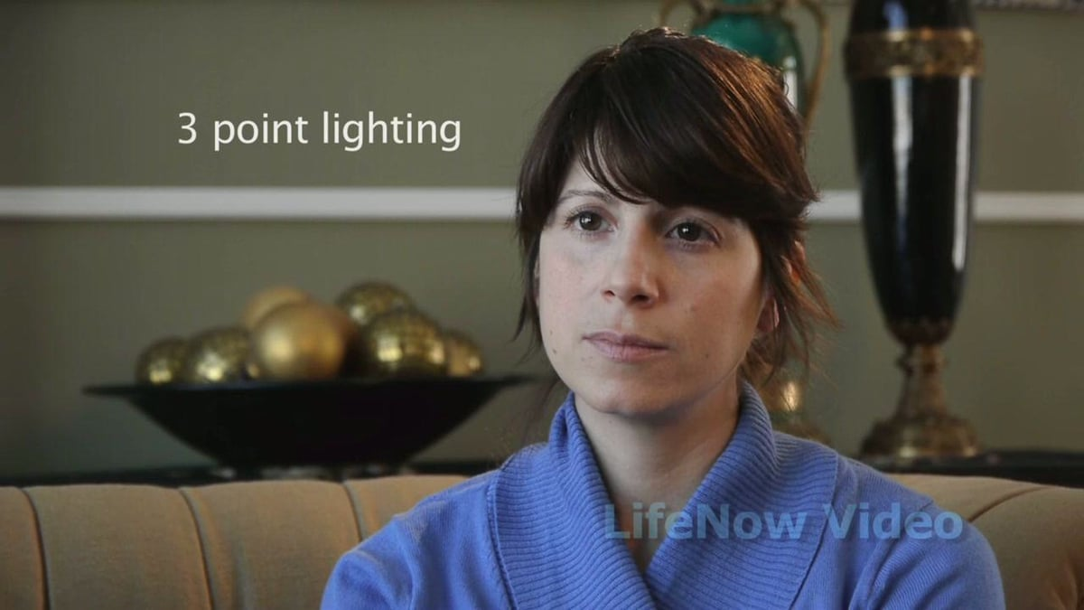
Example

Slide 11
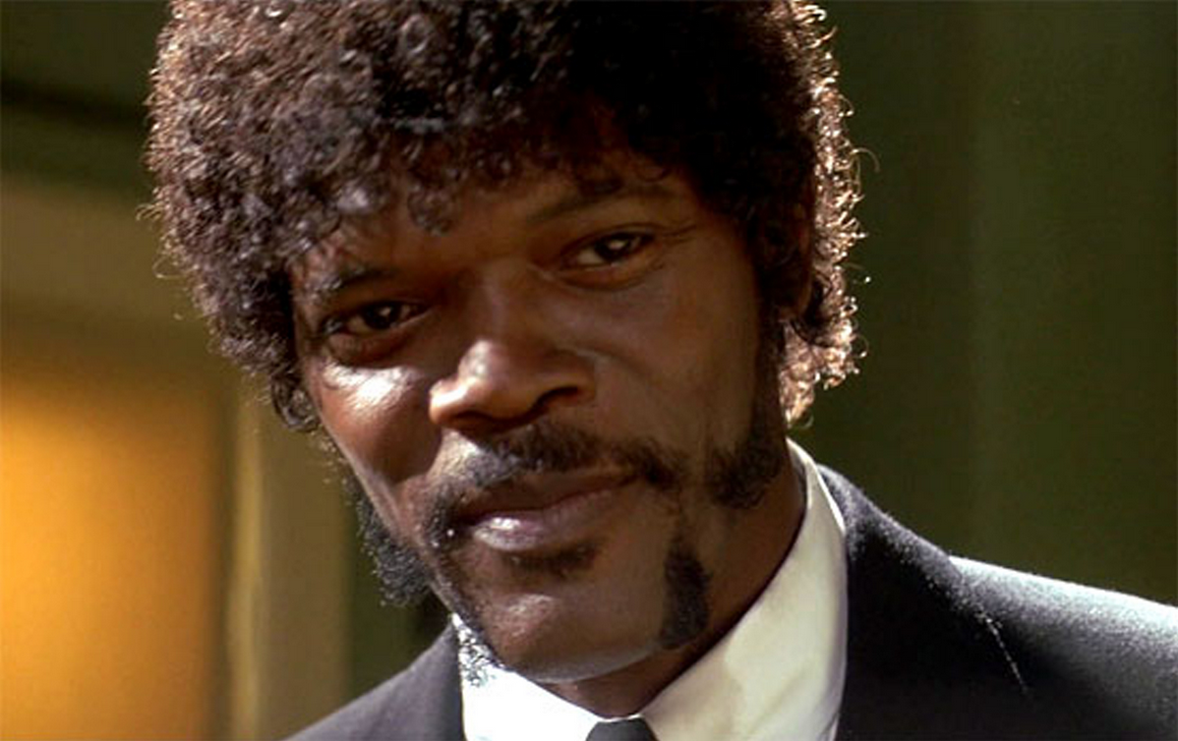
Example

Slide 12
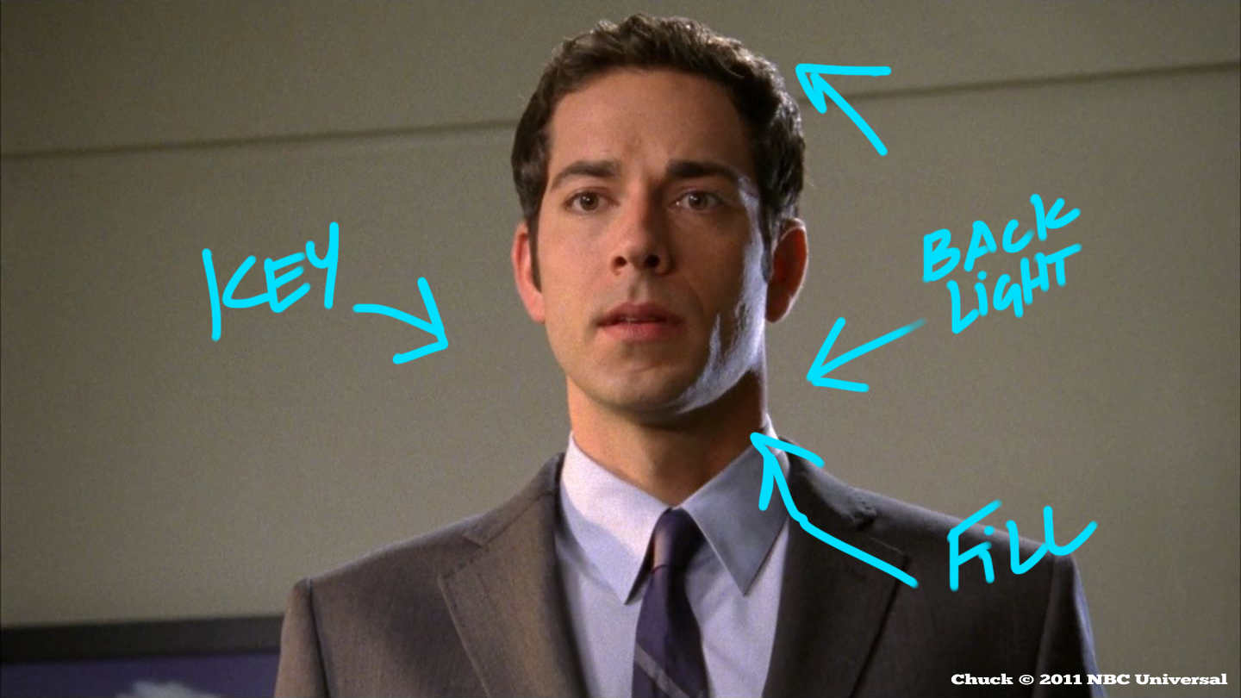
Example

Slide 13
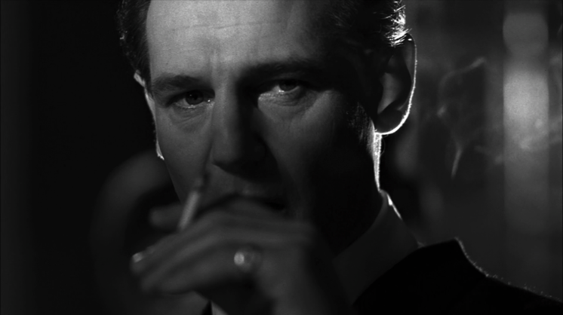
Basic Lighting Techniques
2 Point Lighting
Uses key light and fill or backlight.
Using key and fill creates a flat/even look for your image.
Using key and back creates a three dimensional look.

Slide 14
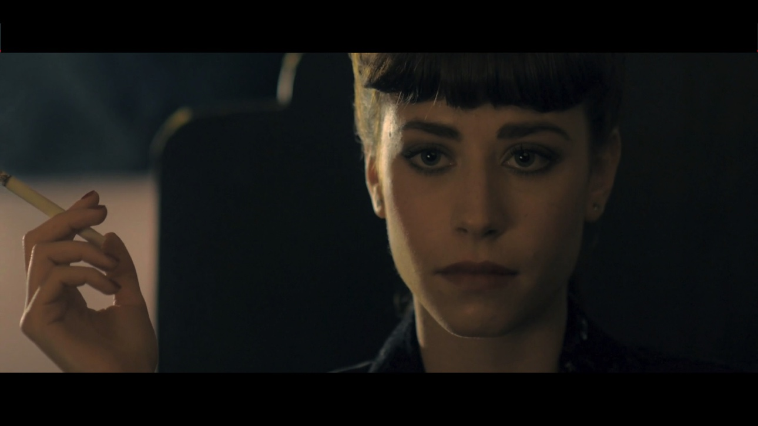
Basic Lighting Techniques
2 Point Lighting

Slide 15
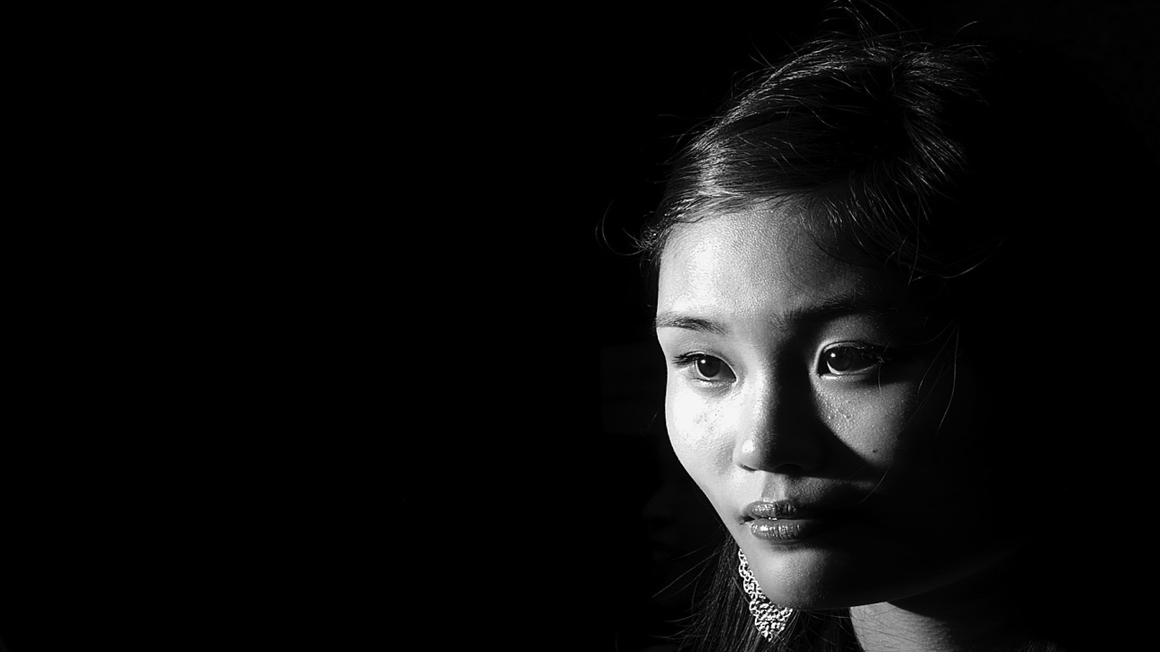
Basic Lighting Techniques
1 Point Lighting
Uses just one light source.
Creates a dramatic/mysterious look for your image.

Slide 16
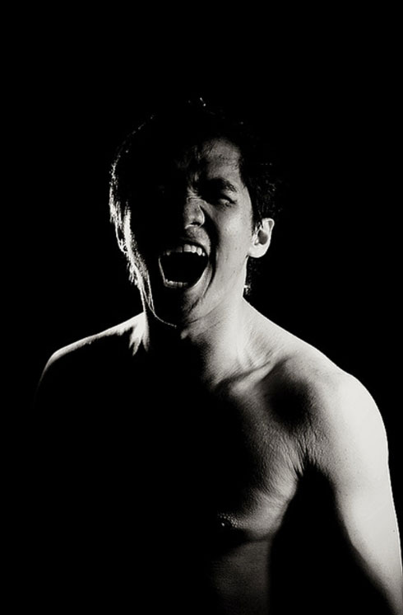
Guess the lighting technique…
2 Point

Slide 17
Guess the lighting technique…
3 Point

Slide 18
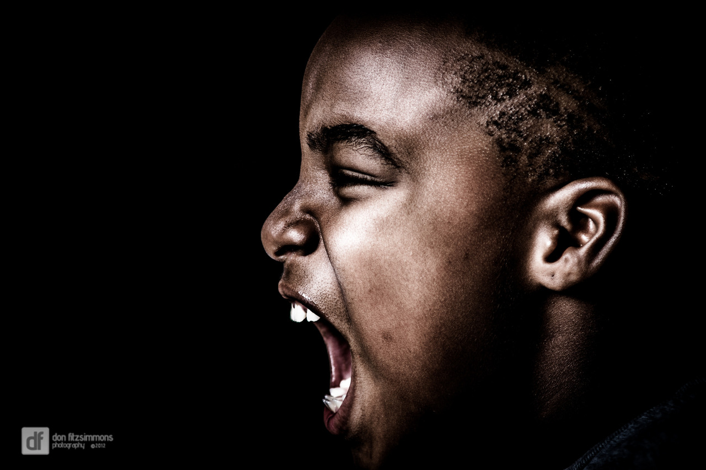
Guess the lighting technique…
1 Point

Slide 19
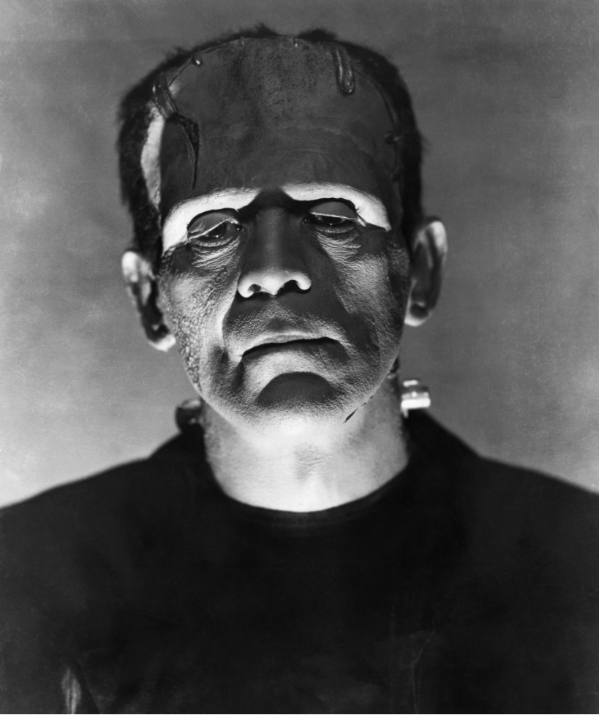
Guess the lighting technique…
2 Point

Slide 20
Now it’s your turn…
Using the class cameras, in groups of 4-6, you and your group are going to capture 2 examples of each of the basic lighting techniques. This assignment is worth a total of 24 points (4 points per photo) and is due at the end of the period.
*Each photo must have a different subject or background!

