Slide 1
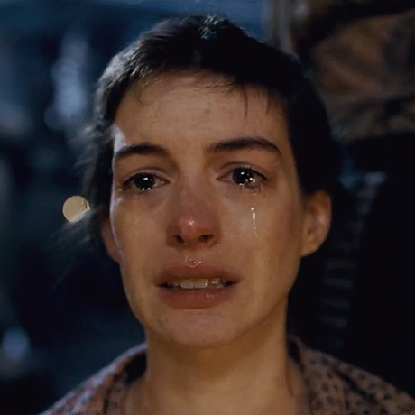
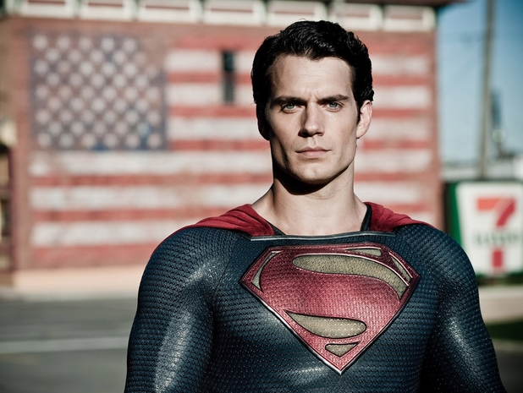
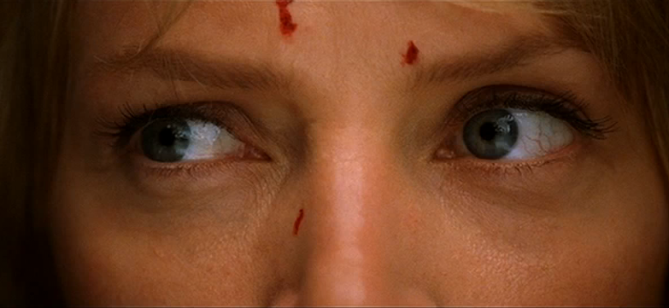
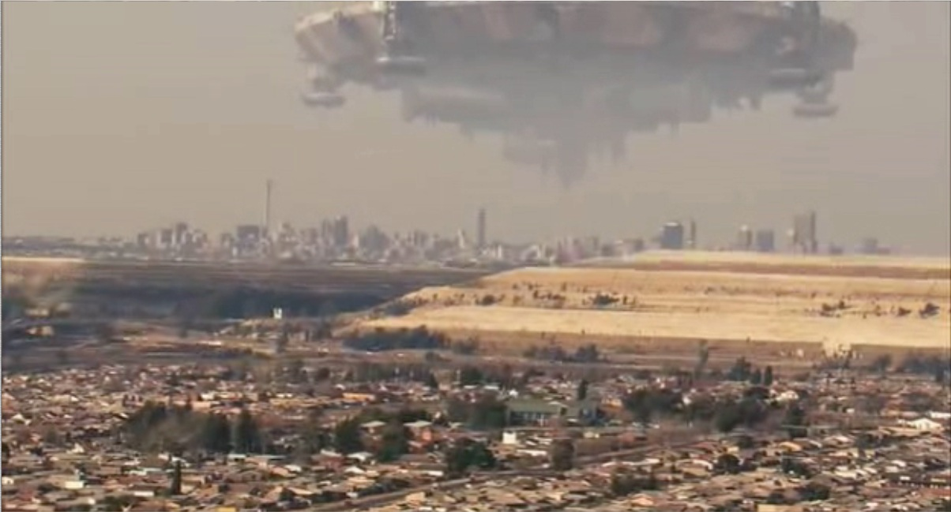
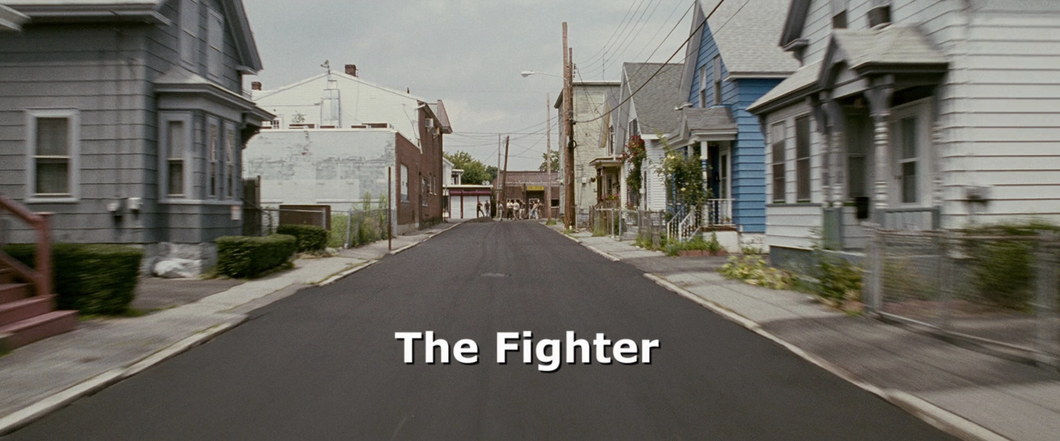
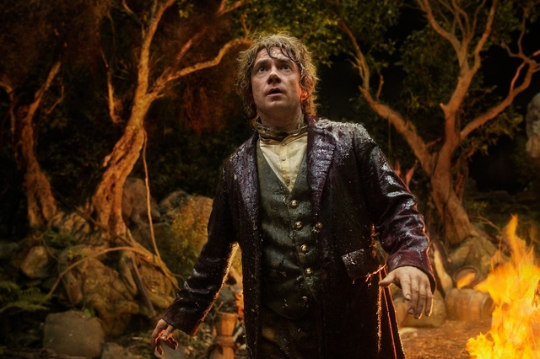
Types of
Shots

Slide 2
“7 Primary” Shots
Long Shot
1.Extreme LS
2.Regular LS
3.Medium LS
4. Medium Shot
Close Up
5.Medium CU
6.Regular CU
7.Extreme CU

Slide 3
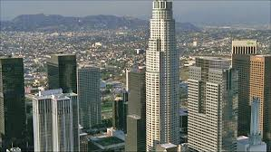
Extreme Long Shot (ELS)
AKA Extreme Wide Shot (EWS). Often used as an establishing shot. Covers a very wide area. Typically used to set up scenes/show locations or show action from a long distance.

Slide 4
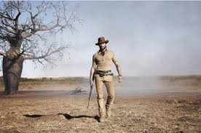
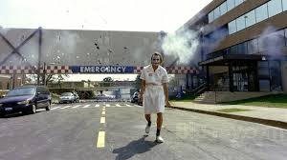
Long Shot (LS)
A Long Shot is a shot where the subject is framed from head to toe. It places the subject in relation to the environment and people around it. Typically used to show the subject, the environment around the subject, and how the subject is reacting to its environment.

Slide 5
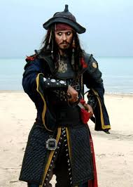
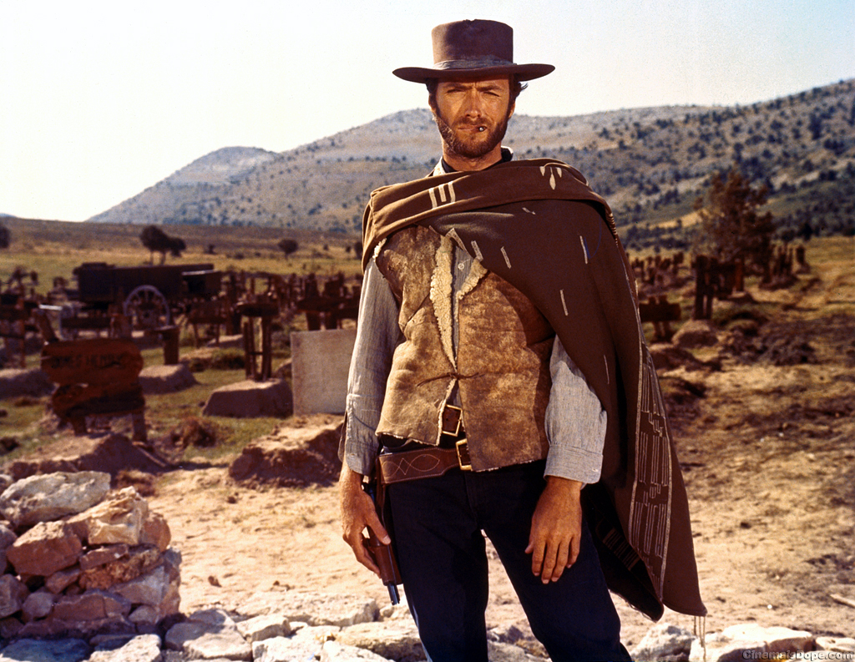
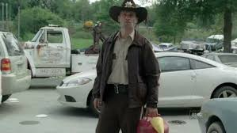
Medium Long Shot (MLS)
AKA 3 Quarters Shot. Framed from the subject’s knees up. Similar to LS, typically used when the director wants to show the subject in relation to the environment around it.
Note: As the shots are framed more and more closely to the subject, their use becomes less about action and more about emotion.

Slide 6
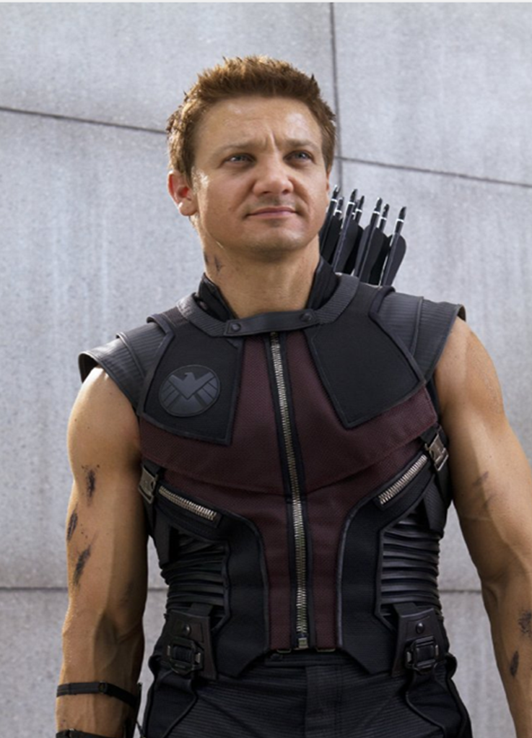
Medium Shot (MS)
Framed from the waist up. Typically used in scenes where there is conversation between two characters/interviews.

Slide 7
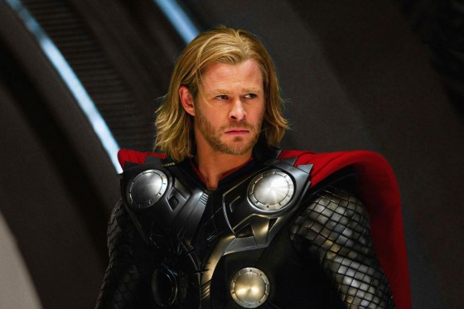
Medium Close Up (MCU)
Framed beginning just above the subject’s elbows and includes the shoulders, chest, neck, and head. Typically used during scenes where there is conversation between characters.

Slide 8
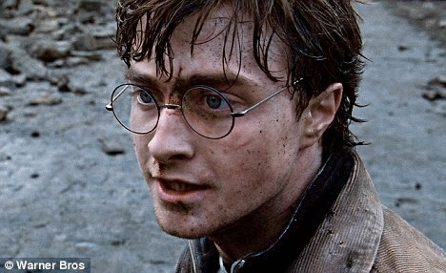
Close Up (CU)
Framed at a very close range to the
subject. It is a shot that typically only contains the subject’s head
(and sometimes shoulders) and is usually used when the director
wants to show the audience the subject’s facial expression.

Slide 9
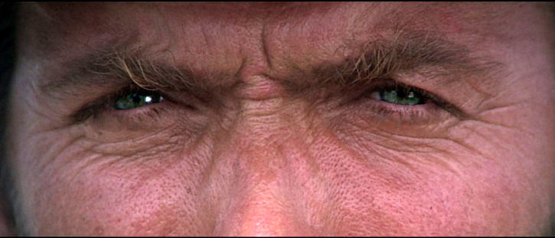
Extreme Close Up (ECU)
Framed at an extremely close
range to the subject. It is a shot that typically only contains the
subject’s eyes and is typically used during intense scenes
to show emotion.

Slide 10
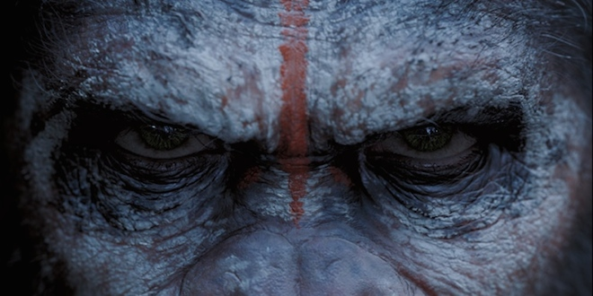
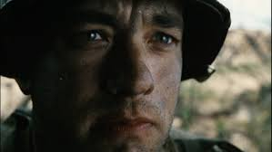
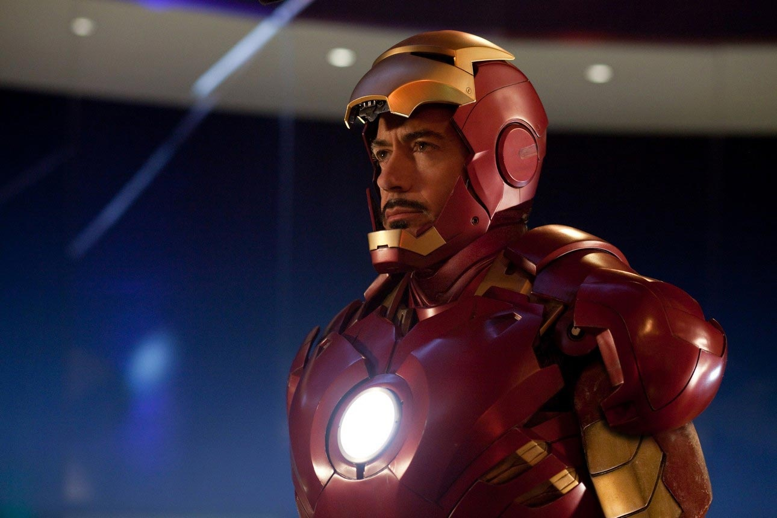
Now it’s your turn…
In groups of 4-6, use the classroom cameras to photograph 2 examples of each of the types of shots discussed in this lecture (ELS, LS, MLS, MS, MCU, CU, ECU). This assignment is worth 42 points (3 points per picture) and is due at the end of the period.
Requirements:
Each photo must be labeled/titled accordingly… (For example, ECU 1, ECU 2, CU 1, CU 2, etc.) (Photos not labeled will lose points!)
2. The photos must be submitted in the File Share folder (in a folder titled with your group member names) and only have the 14 required photos in it.

