Slide 1
Editing

Slide 2
Editing
Video editing is the process of manipulating video, images, and audio to create a new work.
It includes adding new clips, removing unwanted clips, and making various adjustments to images and audio.

Slide 3
Editors are often seen as one of the most powerful people on the production team.
-Editors have the power to make bad acting look good and good acting look bad.
-Editing can be used to manipulate…
-Time
-Tone
-Perspective

Slide 4
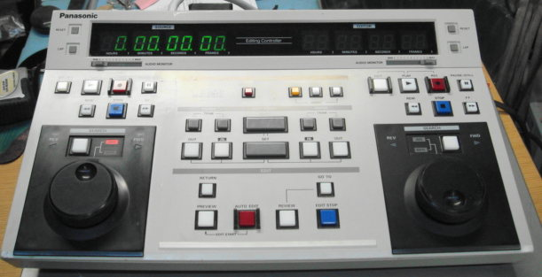
Types of Editing
Linear Editing-
“Old School” Tape-to-tape editing.

Slide 5
Linear Editing- “Old School” Tape-to-tape editing.

Slide 6
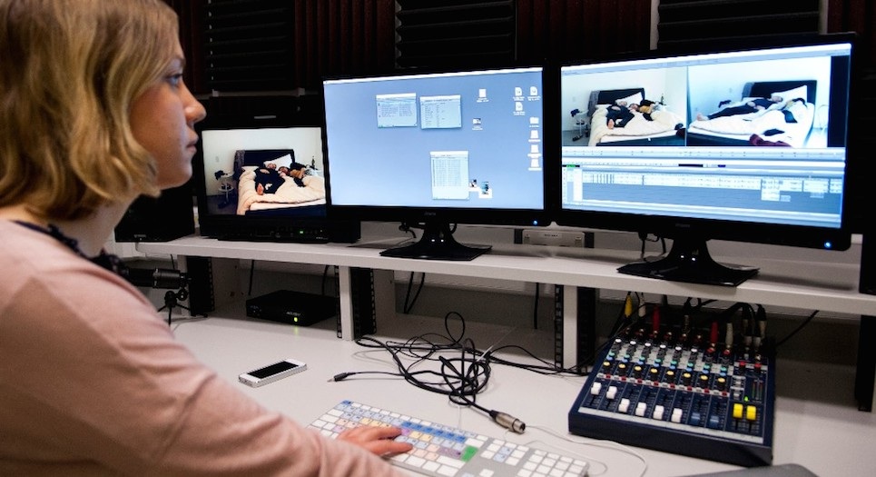
Types of Editing
Non-Linear Editing- Digital editing.

Slide 7
Key Terms
Types of Cuts
Cutaway – A shot of something outside the frame that can be used to hide an edit.
Hard Cut – A cut from one shot or scene to another without any transition effects. In other words, this is the most basic/standard type of cut used in video editing.
Jump Cut – A cut between two different shots that are almost completely identical.

Slide 8
Key Terms
Transitions
Cross-fade – A video transition where the frames in one clip fade to black while the frames in the next clip fade in from black.
Dissolve – A video transition where one shot gradually fades into another shot.
Fade – A transition where a video or sound clip gradually increases or decreases in brightness, usually to or from black.

Slide 9
Key Terms
Transitions
Wipe – Transition from one shot to another, where a moving line or pattern reveals the new shot. Common forms include a page being turned or a window shade being drawn. (Star Wars)

Slide 10
Key Terms
Tools and Techniques
Splicing – Cutting/Placing two shots together.
Split - A straight cut made to separate one video clip into two.
Timeline - A view of the workspace that focuses on the timing of your clips.

Slide 11
Key Terms
Tools and Techniques
Trim - To shorten the length of time for which a clip plays.

Slide 12
Key Terms
Other Terms
Blu Ray – Similar to DVD but has a higher capacity of storage. Format is High Definition.
Chroma Key – Green Screen
Clip - Single piece of video/audio, often containing an individual shot or scene.
DVD - Digital Versatile Disc

Slide 13
Key Terms
Other Terms
FPS -
Refers to the number of “frames” shown on a screen per second. The standard in film is 24 FPS. The standard for video is 29.97 or 30 FPS. The standard for television is 59.94 or 60 FPS.

