Slide 1
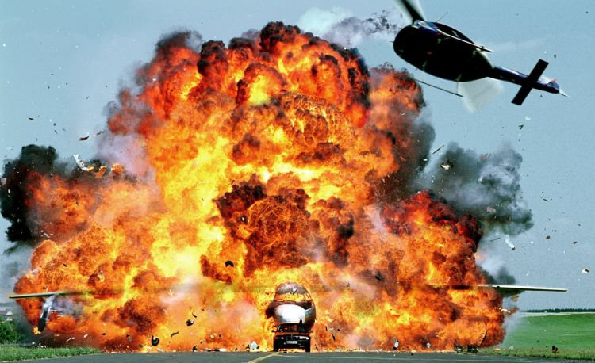
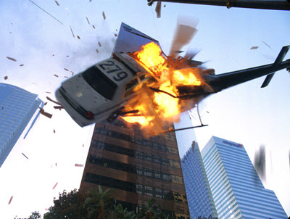
Match on
Action!

Slide 2
What is...
Match on
Action?
Match on action is an editing style which the editor uses to create continuity of action or movement between a series of shots.

Slide 3
How to...
Match on
Action?
1. Cut in the middle of the action
This includes…
Actor/Object Movement
Walking, Punching, Sitting, Kicking, Throwing, Closing Doors, etc.
Direction Changes
Turning Around, Looking Left, Then Looking Right, etc.

Slide 4
How to...
Match on
Action?
2. “Try” to avoid letting your actor walk out of frame before you cut.
* This is not a bad thing, however, letting your actor walk out of frame usually indicates the passing of time, which could defeat the purpose of Matching on Action (which is to create fluid movement and, to a degree, time within a scene.).

Slide 5
How to...
Match on
Action?
3. When an actor is walking across the screen, try to avoid letting the actor cross so much, we see the back of their head.
Example
* This is technically a direction change anyway :)

Slide 6
Additional Tips…
-The action in one shot does not always have to pick up exactly where the action in the shot before it left off
-In many action scenes the editor will take several frames of action off in between shots.
-This helps create the illusion that the action in the scene is happening at a much faster pace than it did in real life.

Slide 7
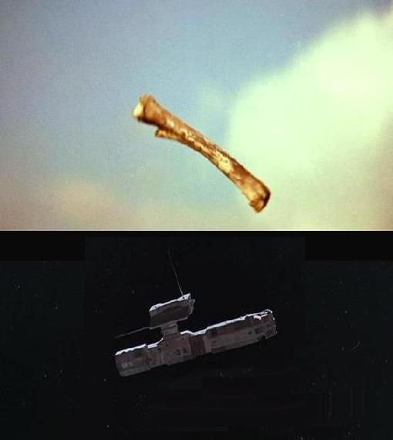
Something worth
Noting
Most Match on Action cuts occur within a scene, but some take place between scenes (This is known as a Match Cut) (i.e.- Stanley Kubrick’s 2001: A Space Odyssey).

Slide 8
2001: A Space Odyssey
Fast and Furious 6
Cuts and Transitions 101

